Slide 1
Unit-2
Spatial filtering
Fundamentals of spatial filtering, Smoothing and sharpening spatial filters, Combining spatial enhancement methods, Using fuzzy techniques for intensity transformations and spatial filtering.

Slide 2
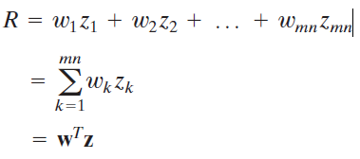
Vector Representation of Linear Filtering
Convolving a mask with an image” often is used to denote the sliding, sum of-products process we just explained, and does not necessarily differentiate between correlation and convolution. Rather, it is used generically to denote either of the two operations.
When interest lies in the characteristic response, R, of a mask either for correlation or convolution, it is convenient sometimes to write the sum of products as –
Where w’s are the coefficients of an m x n filter and the z’s are the corresponding image intensities encompassed by the filter.

Slide 3
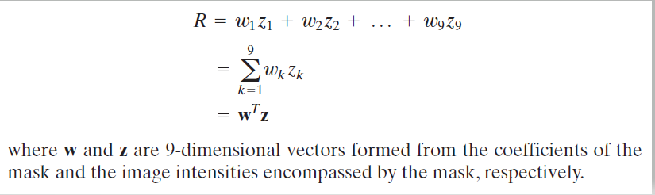
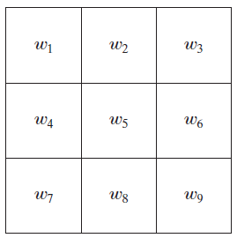
Another representation of a general 3x3 filter mask.

Slide 4
Smoothing Spatial Filters
Smoothing filters are used for blurring and for noise reduction.
Blurring is used in preprocessing tasks, such as removal of small details from an image prior to (large) object extraction,
Smoothing Linear Filters –
The output (response) of a smoothing, linear spatial filter is simply the average of the pixels contained in the neighborhood of the filter mask.
These filters sometimes are called averaging filters.
They also are referred to a lowpass filters.

Slide 5
Smoothing Linear Filters –
By replacing the value of every pixel in an image by the average of the intensity levels in the neighborhood defined by the filter mask, this process results in an image with reduced “sharp” transitions in intensities.
Because random noise typically consists of sharp transitions in intensity levels, the most obvious application of smoothing is noise reduction.
However, edges (which almost always are desirable features of an image) also are characterized by sharp intensity transitions, so averaging filters have the undesirable side effect that they blur edges

Slide 6
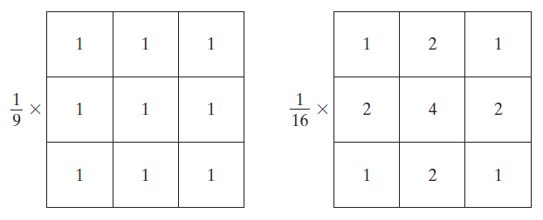

Smoothing Linear Filters –Average filter
Use of the first filter yields the standard average of the pixels under the mask.
Which is the average of the intensity levels of the pixels in the neighborhood defined by the mask
Two 3x3 smoothing (averaging) filter masks.
The constant multiplier in front of each mask is equal to 1 divided by the sum of the values of its coefficients, as is required to compute an average.
A spatial averaging filter in which all coefficients are equal sometimes is called a box filter

Slide 7
Smoothing Linear Filters –Average filter
The second mask in Figure is a little more interesting. This mask yields a so called weighted average, terminology used to indicate that pixels are multiplied by different coefficients, thus giving more importance (weight) to some pixels at the expense of others.
The basic strategy behind weighing the center point the highest and then reducing the value of the coefficients as a function of increasing distance from the origin is simply an attempt to reduce blurring in the smoothing process

Slide 8
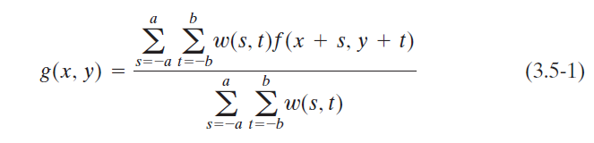
Smoothing Linear Filters –Average filter
The general implementation for filtering an M X N image with a weighted averaging filter of size m x n (m and n odd) is given by the expression-
It is understood that the complete filtered image is obtained by applying above equation for x=0,1,2,3…,M-1 ad y=0,1,2,3,….N-1.
The denominator is simply the sum of the mask coefficients and, therefore, it is a constant that needs to be computed only once.

Slide 9
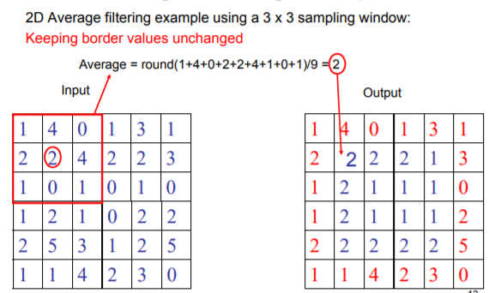
Smoothing Linear Filters – Averaging Filter

Slide 10
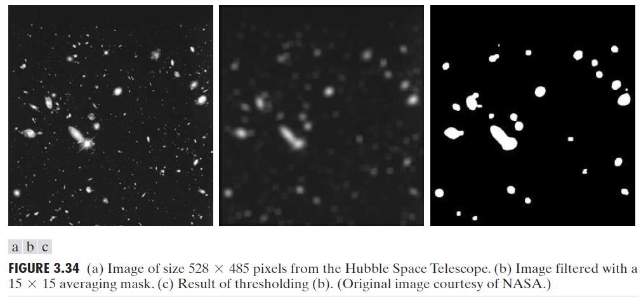
Smoothing Linear Filters – Averaging Filter
An important application of spatial averaging is to blur an image for the purpose of getting a gross representation of objects of interest, such that the intensity of smaller objects blends with the background and larger objects become “bloblike” and easy to detect.
The size of the mask establishes the relative size of the objects that will be blended with the background.
We see that a number of objects have either blended with the background or their intensity has diminished considerably.
It is typical to follow an operation like this with thresholding to eliminate objects based on their intensity

Slide 11
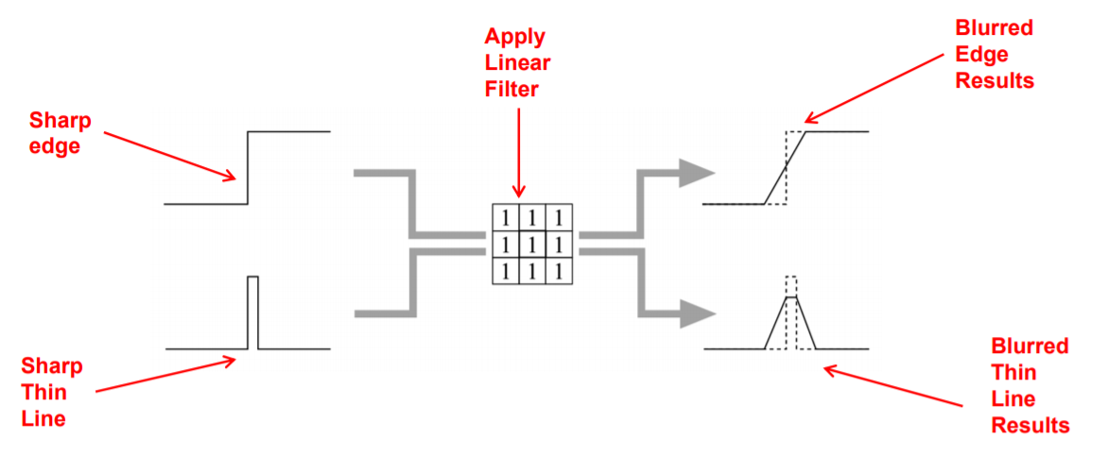
Smoothing Linear Filters
Linear filters blurs all image structures points, edges and lines, reduction of image quality
Linear filters thus not used a lot for removing noise

Slide 12
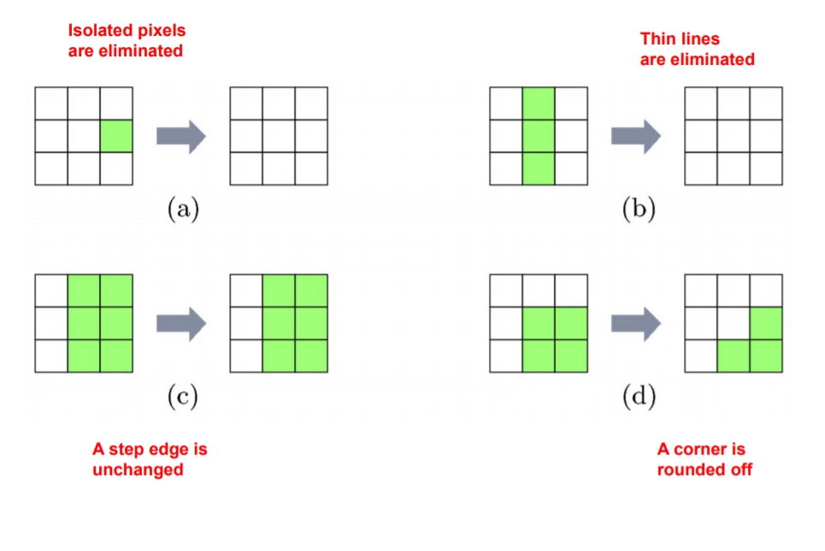
Smoothing Order-Statistic (Nonlinear) Filters
Order-statistic filters are nonlinear spatial filters whose response is based on ordering (ranking) the pixels contained in the image area encompassed by the filter, and then replacing the value of the center pixel with the value determined by the ranking result.
Illustration: Effects of Median Filter

Slide 13
Smoothing Nonlinear Filters - Median
The best-known filter in this category is the median filter, which, as its name implies, replaces the value of a pixel by the median of the intensity values in the neighborhood of that pixel (the original value of the pixel is included in the computation of the median).
Median filters are quite popular because, for certain types of random noise, they provide excellent noise-reduction capabilities, with considerably less blurring than linear smoothing filters of similar size.
Median filters are particularly effective in the presence of impulse noise, also called salt-and-pepper noise because of its appearance as white and black dots superimposed on an image.
The median, of a set of values is such that half the values in the set are less than or equal to the median and half are greater than or equal to the median

Slide 14
Smoothing Nonlinear filters – Median Filters
The median filter works by moving through the image pixel by pixel, replacing each value with the median value of neighbouring pixels.
The pattern of neighbours is called the "window", which slides, pixel by pixel over the entire image 2 pixel, over the entire image.
In order to perform median filtering at a point in an image, we first sort the values of the pixel in the neighborhood, determine their median, and assign that value to the corresponding pixel in the filtered image.
Note that noise pixels are considered to be very different from the median. Using this idea median filter can remove this type of noise problems while preserving edges.

Slide 15
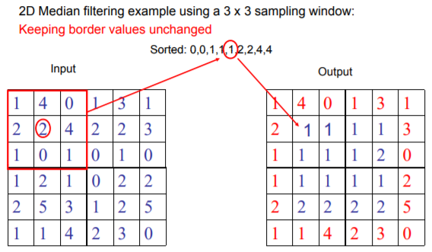
Smoothing Nonlinear filters – Median Filters

Slide 16
Other Non-linear Filters
Although the median filter is by far the most useful order-statistic filter in image processing, it is by no means the only one.
The median represents the 50th percentile of a ranked set of numbers,
Using the 100th percentile results in the so-called max filter, which is useful for finding the brightest points in an image.
The 0th percentile filter is the min filter, used for the opposite purpose.

Slide 17
Sharpening Spatial Filters- High Pass Filter
The principal objective of sharpening is to highlight transitions in intensity.
Averaging is analogous to integration, it is logical to conclude that sharpening, can be accomplished by spatial differentiation.
Fundamentally, the strength of the response of a derivative operator is proportional to the degree of intensity discontinuity of the image at the point at which the operator is applied.
Thus, image differentiation enhances edges and other discontinuities (such as noise) and de-emphasizes areas with slowly varying intensities.

Slide 18
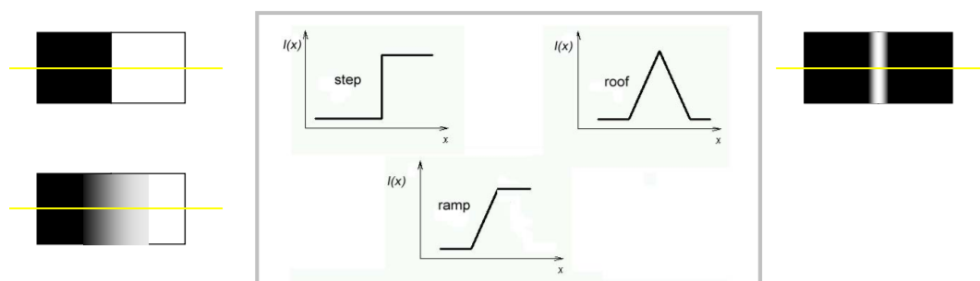
Edge Definition
Edge is a boundary between two regions with relatively distinct gray level properties.
Edges are pixels where the brightness function changes abruptly.

Slide 19
000000030 60 90 120 150 180 210 240 255 255 255 255 255 255

Slide 20
Sharpening Spatial Filters - Foundation
In the two sections that follow, we will discuss sharpening filters that are based on first- and second-order derivatives, respectively.
We will focus attention initially on one-dimensional derivatives.
In particular, we are interested in the behavior of these derivatives in areas of-
constant intensity,
at the onset and end of discontinuities (step and ramp discontinuities),
and along intensity ramps.

Slide 21
Sharpening Spatial Filters - Foundation
The derivatives of a digital function are defined in terms of differences.
There are various ways to define these differences. However, we require that any definition we use for a first derivative-
must be zero in areas of constant intensity;
must be nonzero at the onset of an intensity step or ramp; and
must be nonzero along ramps.
Similarly, any definition of a second derivative
must be zero in constant areas;
must be nonzero at the onset and end of an intensity step or ramp; and
must be zero along ramps of constant slope.

Slide 22
Sharpening Spatial Filters - Foundation
Basic definition of first-order derivative of a one-dimensional function given by the difference-
∂f/∂x = f(x + 1) − f(x)
Second-order derivative is defined as the difference-
∂²f/∂x² = f(x + 1) + f(x − 1) − 2f(x)
Explanation- ∂²f/∂x² = ( f(x + 1) – f(x) ) – ( f(x) – f(x-1) )
∂²f/∂x² = ( f(x + 1) – f(x) - f(x) + f(x-1) )
∂²f/∂x² = ( f(x + 1) – 2f(x) + f(x-1) )

Slide 23
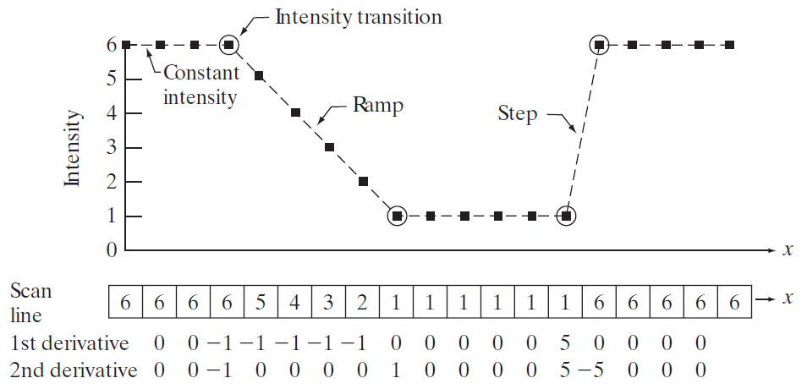
Illustration of the first and second derivatives of a 1-D digital function
As the figure shows, the scan line contains an intensity ramp, three sections of constant intensity, and an intensity step.
The circles indicate the onset or end of intensity transitions.
A section of a horizontal intensity profile from an image

Slide 24
Illustration of the first and second derivatives of a 1-D digital function
When computing the first derivative at a location x, we subtract the value of the function at that location from the next point. So this is a “look-ahead” operation
In this method we take the 1 st derivative of the intensity value across the image and find points where the derivative is maximum then the edge could be located.
Similarly, to compute the second derivative at x, we use the previous and the next points in the computation.
To avoid a situation in which the previous or next points are outside the range of the scan line, we show derivative computations in Figure, from the second through the penultimate (second last) points in the sequence.

Slide 25
Illustration of the first and second derivatives of a 1-D digital function
First, we encounter an area of constant intensity and, as Figures show, both derivatives are zero there, so condition (1) is satisfied for both.
Next, we encounter an intensity ramp followed by a step, and we note that the first-order derivative is nonzero at the onset of the ramp and the step
similarly, the second derivative is nonzero at the onset and end of both the ramp and the step; therefore, property (2) is satisfied for both derivatives
we see that property (3) is satisfied also for both derivatives because the first derivative is nonzero and the second is zero along the ramp.

Slide 26
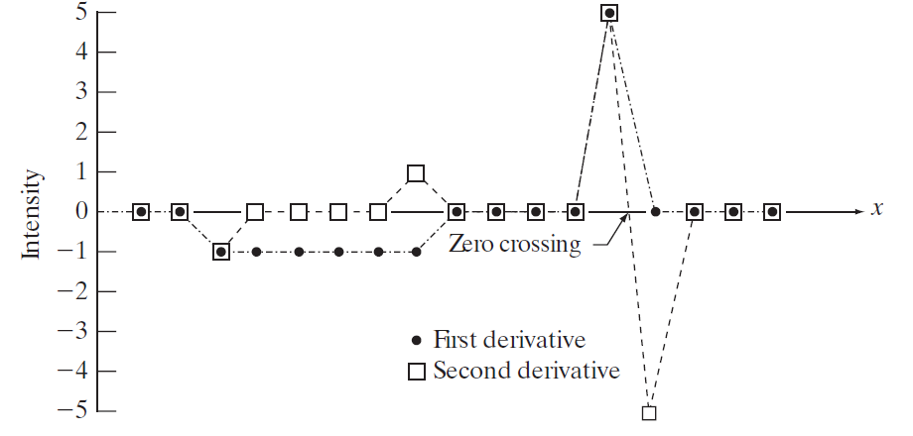
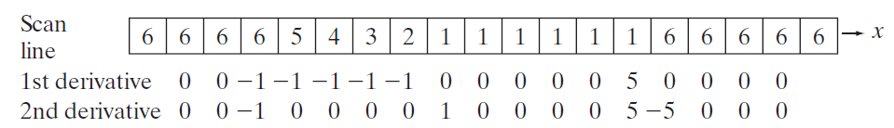
Illustration of the first and second derivatives of a 1-D digital function
Note that the sign of the second derivative changes at the onset and end of a step or ramp.
The 2nd derivative of an image where the image highlights regions of rapid intensity change and is therefore often used for edge detection- zero crossing edge detectors.

Slide 27
Using the Second Derivative for Image Sharpening
The approach basically consists of defining a discrete formulation of the second-order derivative and then constructing a filter mask based on that formulation.
We are interested in isotropic filters, whose response is independent of the direction of the discontinuities in the image to which the filter is applied.
In other words, isotropic filters are rotation invariant, in the sense that rotating the image and then applying the filter gives the same result as applying the filter to the image first and then rotating the result.

Slide 28
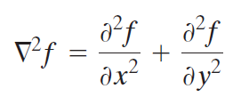
Image Sharpening Filter -The Laplacian
The simplest isotropic derivative operator is the Laplacian which, for a function (image) f(x,y) of two variables, is defined as-
the Laplacian is a linear operator.
To express this equation in discrete form, we use the definition in equation ∂²f/∂x² = f(x + 1) + f(x − 1) − 2f(x), keeping in mind that we have to carry a second variable-
In the x-direction, we have- ∂²f/∂x² = f(x + 1, y) + f(x − 1, y) − 2f(x,y) …..1
In the y-direction we have - ∂²f/∂y² = f(x, y + 1) + f(x , y - 1) − 2f(x,y) …..2

Slide 29
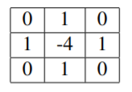
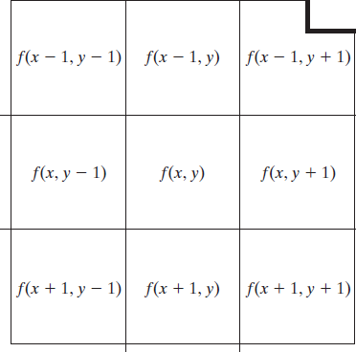
Image Sharpening Filter -The Laplacian
Therefore, it follows from the preceding three equations that the discrete Laplacian of two variables is given by taking the sum of partials -
∇²f(x, y) = f(x + 1, y) + f(x - 1, y) + f(x, y + 1) + f(x, y - 1) - 4f(x, y) ….3
The mask is given by –
The mask gives isotropic result in increments of 90◦

Slide 30
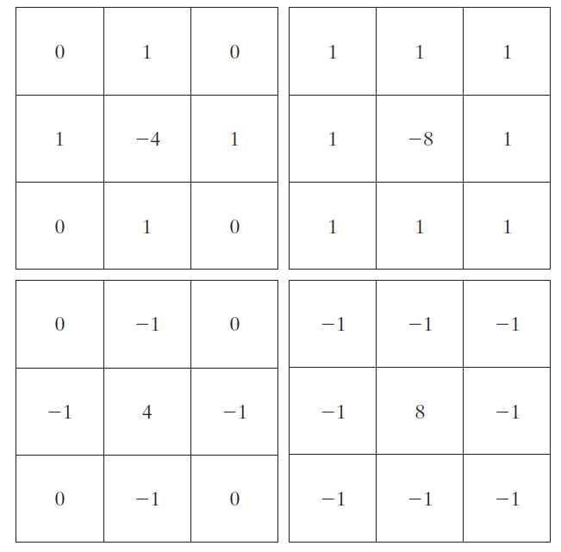

Image Sharpening Filter -The Laplacian
The diagonal directions can be incorporated in the definition of the digital Laplacian by adding two more terms to Equation 3, one for each of the two diagonal directions.
The form of each new term is the same as either Eq. 1 or 2, but the coordinates are along the diagonals.
Fig. (a) Filter mask used to implement Eq. 3
Fig. (b) Mask used to implement an extension of this equation that includes the diagonal terms.
Fig. (c) and (d) Two other implementations of the Laplacian found frequently in practice.
FIGURE 3.37

Slide 31
Image Sharpening Filter -The Laplacian
Because the Laplacian is a derivative operator, its highlights intensity discontinuities in an image and de-emphasizes regions with slowly varying intensity levels.
This will tend to produce images that have grayish edge lines and other discontinuities, all superimposed on a dark, featureless background.
Background features can be “recovered” while still preserving the sharpening effect of the Laplacian simply by adding the Laplacian image to the original.
it is important to keep in mind which definition of the Laplacian is used. If the definition used has a negative center coefficient, then we subtract, rather than add, the Laplacian image to obtain a sharpened result.

Slide 32

Image Sharpening Filter -The Laplacian
Thus, the basic way in which we use the Laplacian for image sharpening is –
Where f(x,y) and g(x,y) are the input and sharpened images, respectively
The constant is c=-1 if the Laplacian filters in Fig. (a) or (b) are used, and c = 1 if either of the other two filters is used.

Slide 33
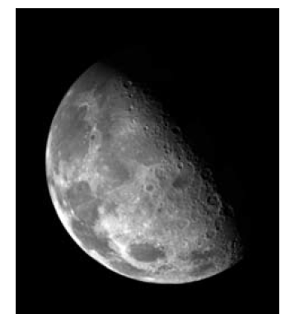
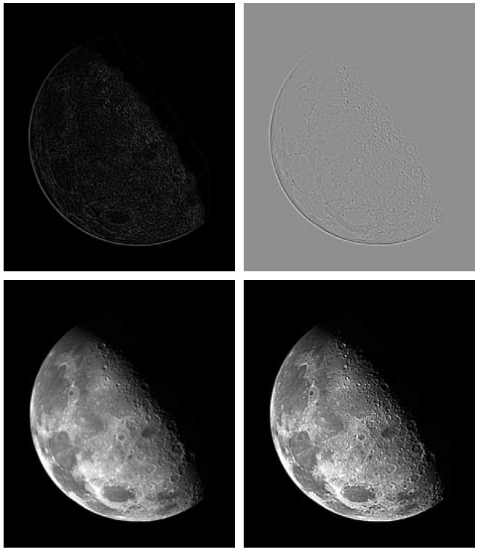
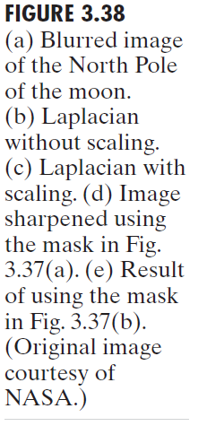



Slide 34
%Input Image
clear all;
pkg load image;
A=imread('coins.png');
size(A);
figure,
subplot(2,2,1);imshow(A); title('original Image');
%Preallocate the matrices with zeros
I1=A;
I=zeros(size(A));
I2=zeros(size(A));
%Filter Masks
#F1=[0 1 0;1 -4 1; 0 1 0];
#F1=[0 2 0;2 -8 2; 0 2 0];
F1=[1 1 1;1 -8 1; 1 1 1];
#F1=[-1 -1 -1;-1 8 -1; -1 -1 -1];
%Padarray with zeros
A=padarray(A,[1,1]);
A=double(A);
size(A);
%Implementation of the equation in Fig.D
for i=1:size(A,1)-2
for j=1:size(A,2)-2
I(i,j)=sum(sum(F1.*A(i:i+2,j:j+2)));
end
end
I=uint8(I);
subplot(2,2,3);imshow(I);title('Filtered Image');
%Sharpenend Image
%Refer Equation in Fig.F
B=I1-I;
subplot(2,2,4); imshow(B);title('Sharpened Image');

Slide 35
Unsharp Masking and High boost Filtering
A process that has been used for many years by the printing and publishing industry to sharpen images consists of subtracting an unsharp (smoothed) version of an image from the original image. This process, called unsharp masking, consists of the following steps:
Blur the original image.
Subtract the blurred image from the original (the resulting difference is called the mask.)
Add the mask to the original.

Slide 36
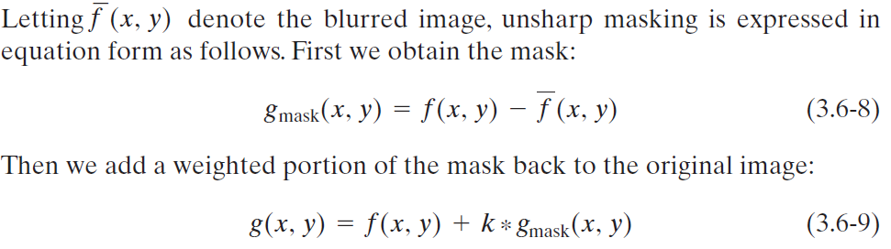
Unsharp Masking and High boost Filtering
where we included a weight, k (k ≥ 0), for generality. When k=1, we have unsharp masking. When k >1, the process is referred to as highboost filtering.

Slide 37
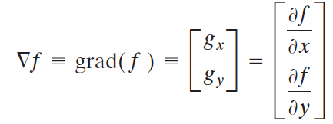
Using First-Order Derivatives for (Nonlinear) Image Sharpening—The Gradient
First derivatives in image processing are implemented using the magnitude of the gradient. For a function f(x,y), the gradient of f at coordinates (x, y) is defined as the two-dimensional column vector-
This vector has the important geometrical property that it points in the direction of the greatest rate of change of f at location (x, y).

Slide 38


Using First-Order Derivatives for (Nonlinear) Image Sharpening—The Gradient
The magnitude (length) of vector ∇f denoted as M(x, y), where M(x,y) is the value at (x, y) of the rate of change in the direction of the gradient vector.
Note that M(x, y) is an image of the same size as the original. It is common practice to refer to this image as the gradient image.
In some implementations, it is more suitable computationally to approximate the squares and square root operations by absolute values:

